Slide 1



Responsive Web Design
BY USING BOOTSTRAP AND JQUERY (Day 3)
Nitipan Pompan

Slide 2
Outline - Day 3
Bootstrap theming and customizations
3rd party library integration
jQuery custom plugins
Homework

Slide 3
Bootstrap theming

Slide 4
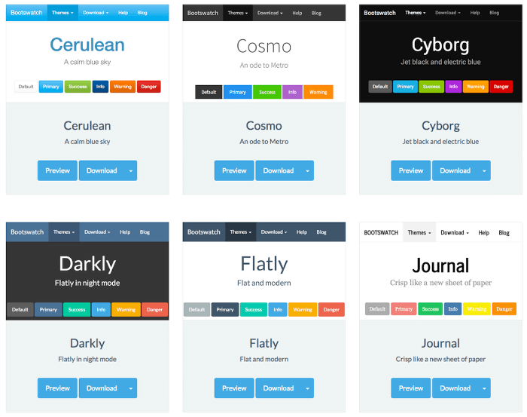
Themes

Slide 5
Bootstrap theming & customization
Multi-appearances
Based-on existings standard class (form-control, card etc..)
Separated custom stylesheet
DO NOT TOUCH original file (css, scss)
2 way to customize
Sass variables, Sass maps
Custom CSS

Slide 6
Custom CSS theming
Seperated stylesheet
override properties on standard css classes from bootstrap

Slide 7
Example
<!-- bootstrap css, html-body above -->
<div class="d-inline-block">
<div class="form-inline m-auto">
<input type="text" class="form-control mr-2" placeholder="Type messages">
<button class="btn btn-primary">Submit</button>
</div>
</div>
<!-- bootstrap js, end of body-html below -->

Slide 8


Example (cont.)
Standard Bootstrap CSS
Customized CSS

Slide 9
Example - customized css
page.html
custom.css
<!-- Bootstrap CSS -->
<link rel="stylesheet" href="https://maxcdn.bootstrapcdn.com/bootstrap/4.0.0/css/bootstrap.min.css" integrity="sha384-Gn5384xqQ1aoWXA+058RXPxPg6fy4IWvTNh0E263XmFcJlSAwiGgFAW/dAiS6JXm"
crossorigin="anonymous">
<link rel="stylesheet" href="custom.css">
<title></title>
</head>
input[type=text].form-control {
border-radius: 5px;
border-width: 2px;
border-color: darkgrey;
background: thistle;
}
button.btn.btn-primary {
background: lightcoral;
border-color: hotpink;
}

Slide 10
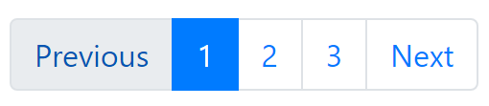
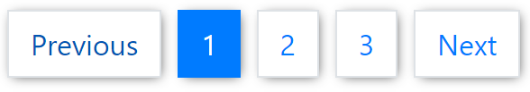
Example 2 - customized css
.page-item:first-child .page-link,
.page-item:last-child .page-link {
border-radius: 0px;
border-width: 1px;
}
.pagination .page-item {
margin-left: 5px;
margin-right: 5px;
color: white;
box-shadow: 1px 1px 10px -2px rgba(0, 0, 0, 0.75);
}

Slide 11
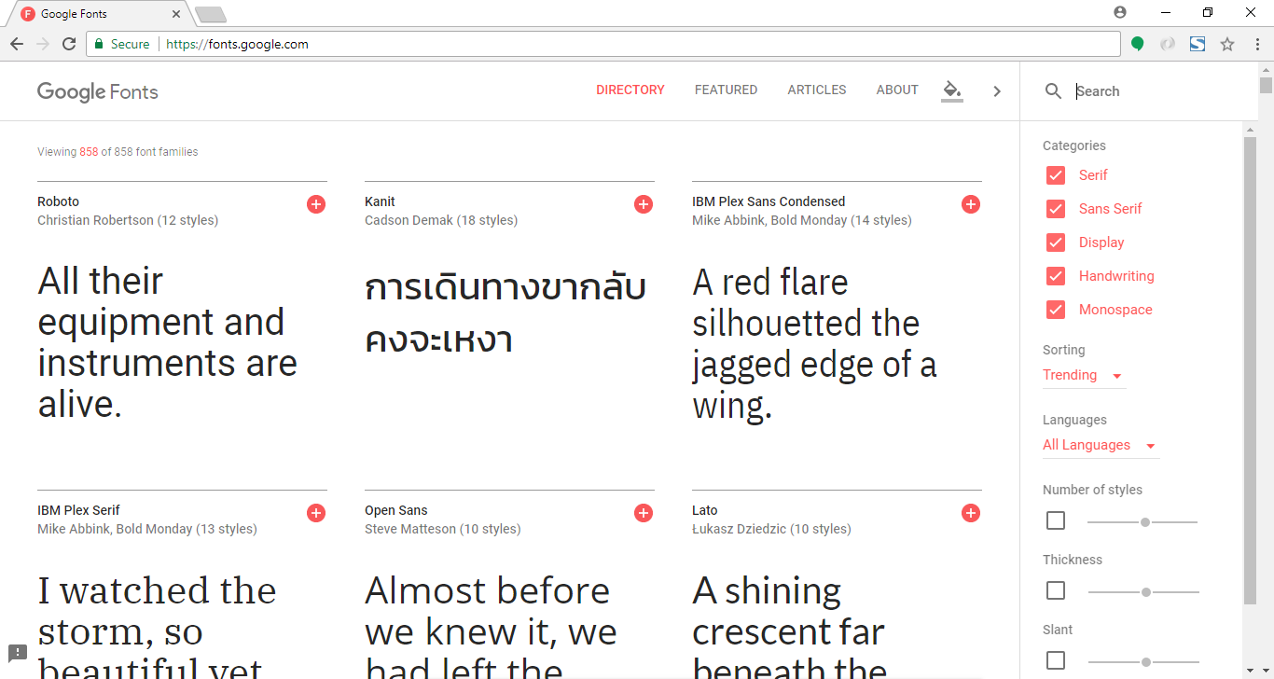
Custom CSS - Google fonts

Slide 12
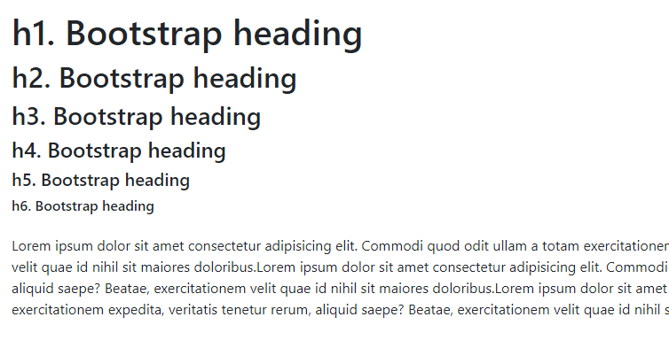
Custom CSS - Google fonts
Standard Bootstrap CSS

Slide 13
Custom CSS - Google fonts
Custom CSS
@import url('https://fonts.googleapis.com/css?family=Open+Sans+Condensed:300');
body {
font-family: 'Open Sans Condensed', sans-serif;
}

Slide 14
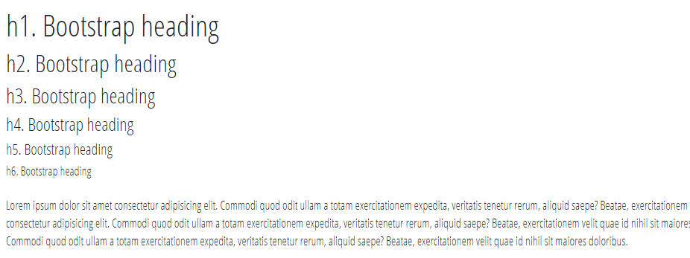
Custom CSS - Google fonts

Slide 15
CSS variables
:root {
--blue: #007bff;
--indigo: #6610f2;
--purple: #6f42c1;
--pink: #e83e8c;
--red: #dc3545;
--orange: #fd7e14;
--yellow: #ffc107;
--green: #28a745;
--teal: #20c997;
--cyan: #17a2b8;
--white: #fff;
--gray: #6c757d;
--gray-dark: #343a40;
--primary: #007bff;
--secondary: #6c757d;
--success: #28a745;
--info: #17a2b8;
--warning: #ffc107;
--danger: #dc3545;
--light: #f8f9fa;
--dark: #343a40;
..

Slide 16
CSS variables
….
--breakpoint-xs: 0;
--breakpoint-sm: 576px;
--breakpoint-md: 768px;
--breakpoint-lg: 992px;
--breakpoint-xl: 1200px;
--font-family-sans-serif: -apple-system, BlinkMacSystemFont, "Segoe UI", Roboto, "Helvetica Neue", Arial, sans-serif, "Apple Color Emoji", "Segoe UI Emoji", "Segoe UI Symbol";
--font-family-monospace: SFMono-Regular, Menlo, Monaco, Consolas, "Liberation Mono", "Courier New", monospace;
}

Slide 17
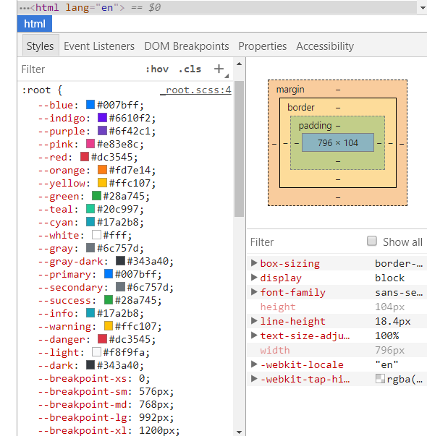
CSS variables in Chrome development tools

Slide 18
How to use CSS variables
.color-dynamic {
color: var(--blue);
}

Slide 19
jQuey custom plugin

Slide 20
jQuery custom plugin - Why ?
Reusable
Encapsulation
Maintainability

Slide 21

Reusable

Slide 22
Encapsulation
What’s inside $(‘dialog’).modal() ?

Slide 23

Maintainability
customer:
“I want to change all of this widget to have edit function”

Slide 24
jQuery custom plugin 101
$.fn.highlight = function () {
$(this).css('color', 'yellow');
};

Slide 25
jQuery custom plugin 101 - how to use
$(function () {
/* other codes */
$('span').highlight();
});

Slide 26
Chaining
$.fn.highlight = function () {
$(this).css('color', 'yellow');
return this;
};

Slide 27
Chaining
$(function () {
/* other codes */
$('span')
.highlight()
.addClass('highlight');
});

Slide 28
Protecting plugin variables
(function ($) {
/* plugin scope */
$.fn.highlight = function () {
$(this).css('color', 'yellow');
return this;
};
})(jQuery);

Slide 29


Plugin 201 - Async button
Normal State
Loading State

Slide 30
Plugin 201 - Async button
(function ($) {
$.fn.async = function (asyncText, promise) {
var host = this;
var originalHtml = $(host).html();
$(host).html(asyncText).prop('disabled', true);
promise.then(function (res) {
$(host).html(originalHtml).prop('disabled', false);
});
return promise;
};
})(jQuery);

Slide 31
Plugin 201 - Async button
$('#btnLoad').click(function () {
var promise = $.get('https://jsonplaceholder.typicode.com/posts');
$(this).async('<i class="fa fa-refresh fa-spin fa-fw"></i> Loading', promise).then(function (result) {
console.log(result);
});
});

Slide 32
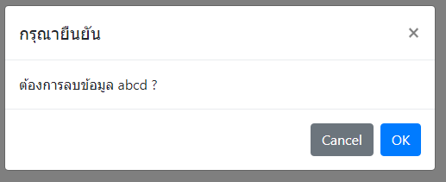
Plugin 301 - Confirm dialog (bootstrap style)

Slide 33
Plugin 301 - Confirm dialog (bootstrap style)
$.fn.confirm = function (title, message) {
var element = this;
var dialog = $('<div class="modal" role="dialog" />');
dialog.html(`
<div class="modal-dialog modal-dialog-centered" role="document">
<div class="modal-content">
<div class="modal-header">
<h5 class="modal-title"">${title}</h5>
<button type="button" class="close" data-dismiss="modal" aria-label="Close">
<span aria-hidden="true">&times;</span>
</button>
</div>
<div class="modal-body">
${message}
</div>
<div class="modal-footer">
<button type="button" class="btn btn-secondary" data-dismiss="modal">Cancel</button>
<button type="button" class="btn btn-primary" role="action-ok">OK</button>
</div>
</div>
</div>
`);

Slide 34
Plugin 301 - Confirm dialog (bootstrap style)
return new Promise((resolve, reject) => {
var isConfirmed = false;
$(dialog).on('hidden.bs.modal', function (e) {
if (isConfirmed)
resolve();
else
reject();
})
dialog.find('button[role="action-ok"]').click(function () {
isConfirmed = true;
dialog.modal('hide');
});
dialog.modal({
backdrop: 'static',
keyboard: false
});
});
}
})(jQuery);

Slide 35
Plugin 301 - Confirm dialog (bootstrap style)
// USAGE
$('button').click(function () {
$('body').confirm('กรุณายืนยัน', 'ต้องการลบข้อมูล abcd ?')
.then(function () {
alert('ok confirm !');
})
.catch(function () {
alert('cancel');
});
});

Slide 36
3rd party library integration

Slide 37
3rd party library integration
ChartJS (http://www.chartjs.org)
Moment.js (https://momentjs.com)

Slide 38

ChartJS
Responsive
8 Chart types
Greate rendering performance by HTML5 Canvas
https://cdnjs.cloudflare.com/ajax/libs/Chart.js/2.7.2/Chart.min.js

Slide 39
ChartJS - quick start (1)
var data = {
labels: [1, 2, 3, 4, 5, 6, 7, 8, 9, 10],
datasets: [{
label: "Prime and Fibonacci",
fillColor: "rgba(220,220,220,0.2)",
strokeColor: "rgba(220,220,220,1)",
pointColor: "rgba(220,220,220,1)",
pointStrokeColor: "#fff",
pointHighlightFill: "#fff",
pointHighlightStroke: "rgba(220,220,220,1)",
data: [2, 3, 5, 7, 11, 13, 17, 19, 23, 29]
}]
};
var lineChart = new Chart($('#chart'), {
type: 'line',
data: data
});
<div class="container">
<div class="row">
<div class="col-md-6">
<canvas id="chart"></canvas>
</div>
</div>
</div>

Slide 40
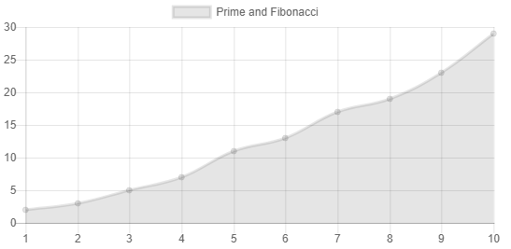
ChartJS - quick start (2)

Slide 41
CDNJS : https://cdnjs.cloudflare.com/ajax/libs/moment.js/2.21.0/moment.min.js
MomentJS
Format date, time
Parse
Manipulation
Validation
Localization (en, th, fr etc..)
/* Format */
moment().format('MMMM Do YYYY, h:mm:ss a'); // March 23rd 2018, 1:33:48 pm
moment().format('dddd'); // Friday
moment().format("MMM Do YY"); // Mar 23rd 18
moment().format('YYYY [escaped] YYYY'); // 2018 escaped 2018
moment().format(); // 2018-03-23T13:33:48+07:00
/* Relative time*/
moment("20111031", "YYYYMMDD").fromNow(); // 6 years ago
moment("20120620", "YYYYMMDD").fromNow(); // 6 years ago
moment().startOf('day').fromNow(); // 14 hours ago
moment().endOf('day').fromNow(); // in 10 hours
moment().startOf('hour').fromNow(); // 34 minutes ago
/* Manipulation */
moment().add(7, 'days');
moment().subtract(7, 'days');

Slide 42
MomentJS - Simple clock
setInterval(function () {
$('#time').html(moment().format('hh:mm:ss'));
}, 1000);

Slide 43
Homework - Dashboard
Reuse main layout from last homework (Admin - Product Catalog)
Create widget plugin for chart (Only one chart type) [ 1 ]
Able to add more widget [ 2 ]
Able to remove more widget [ 2 ]
The dashboard able to change widget themes [ 3 ]
The widget - reloading frequency adjustable (every 30 sec, 5 min or 30 min) [ 4 ]

Slide 44
Homework - Dashboard hint
Use real-time Chart plugins to create your own widget from https://github.com/nitipan/codecampjs/releases/download/v1.0.0/codecamp.js and extends it to be more funtionality
jQuery DOM Manipulation
Bootstrap components to build widget (card, dropdown, button group etc..)

Slide 45
Codecamp - real-time chart plugin
Include scripts below bootstrap javscript and before </body>
<script src="https://cdnjs.cloudflare.com/ajax/libs/moment.js/2.21.0/moment.min.js"></script>
<script src="https://cdnjs.cloudflare.com/ajax/libs/Chart.js/2.7.2/Chart.min.js">
</script>
<script src="https://github.com/nitipan/codecampjs/releases/download/v1.0.0/codecamp.js"></script>
<!-- Your script-->
<script src="app.js"></script>

Slide 46
Real-time chart plugin
2) Example source code how to init real-time chart - this snippet should be on your widget plugin
$('#chart').realtimeChart(2000, {
dataset: {
label: 'Widget 1',
borderColor: 'rgb(255, 99, 132)',
backgroundColor: 'rgba(255, 99, 132, 0.5)'
}
});

Slide 47
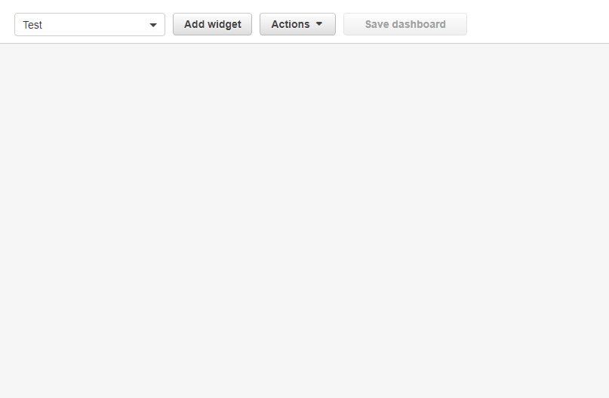
Example - AWS Cloudwatch dashboard

Slide 48
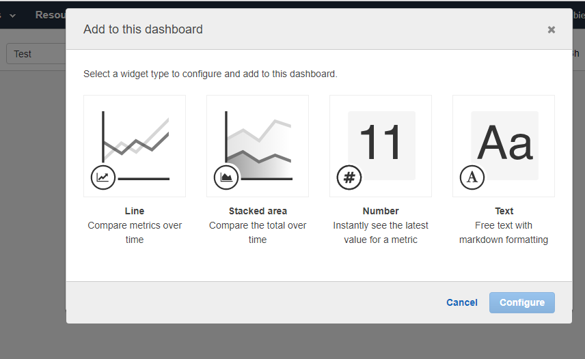
Example - AWS Cloudwatch dashboard

Slide 49
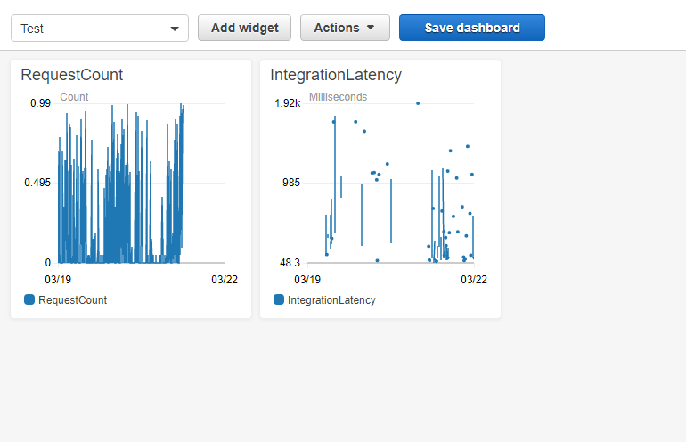
Example - AWS Cloudwatch dashboard

Slide 50
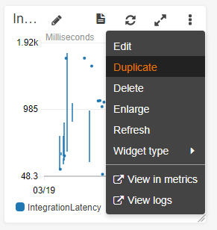
Example - AWS Cloudwatch dashboard

Slide 51
Take away
Plugins is a way to component-based design for javascript framework
Custom CSS get the bootstrap out of the box
jQuery and other 3rd party library is a good combination

